Slide 1

California Housing
Project
California Housing Market
By: Alex Heang, Dykie Smith & Gabriel Andaya

Slide 2
I. Introduction
A.Brief overview of the California Housing Project and its objectives
The purpose of this project is to find the median house value in relation to the distance of certain metropolitan such as San Diego, San Francisco, San Jose and Los Angeles.
This project will also demonstrate median household income, median age of the house, and proximity of the house to a metropolitan area.

Slide 3
II. Background on the California Housing Market
A. Overview of the housing crisis in California
B.Key challenges facing the California housing market today
The California housing market has undergone significant changes and challenges over the last 20 years, including the rising house prices and shortage of affordable housing g
Metropolitan areas such as San Diego, San Francisco, San Jose, and Los Angeles have particularly high housing prices, making it challenging to develop affordable housing solutions in these areas.
Median household income varies significantly by metropolitan area, which could impact the affordability of housing in different parts of the state
The age of housing stock also varies by metropolitan area, which could impact the availability and cost of affordable housing.
Proximity to job centers and public transit may also impact the affordability of housing, as areas closer to these amenities may be in higher demand and have higher prices.
Addressing the challenges facing the California housing market will require innovative solutions and collaboration among policymakers, housing advocates, and other stakeholders in the state.
Promoting sustainable and equitable development, increasing the supply of affordable housing, and addressing the housing shortage and affordability crisis are some of the key priorities in the California housing market today.

Slide 4
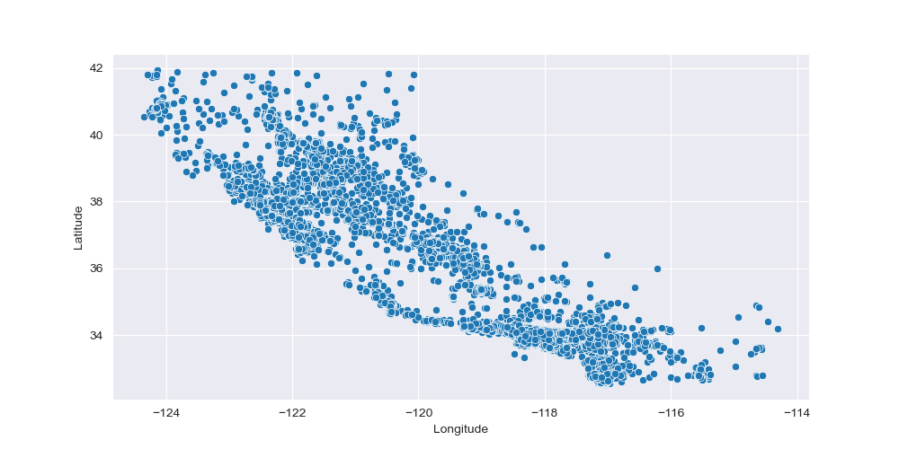
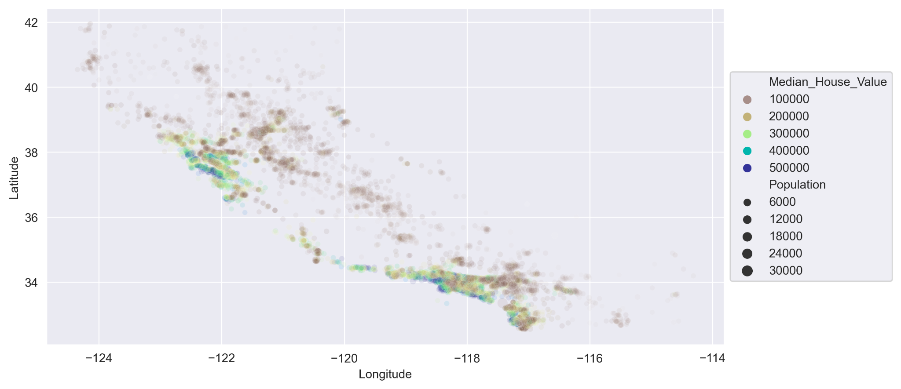

Slide 5
III. Statistics on the California Housing Market
A.Median home price by metropolitan area
B.Median household income by metropolitan area
C.Median age of housing stock by metropolitan area
Median Home Price by Metropolitan Area: According to Zillow, the median home value in San Diego as of March 2023 is $816,087, while in San Francisco it is $1,931,736, in San Jose it is $1,674,835, and in Los Angeles it is $874,243.
Median Household Income by Metropolitan Area: According to the U.S. Census Bureau, the median household income in San Diego County in 2019 was $79,673, in San Francisco County it was $123,859, in Santa Clara County (which includes San Jose) it was $128,523, and in Los Angeles County it was $71,219.
Median Age of Housing Stock by Metropolitan Area: According to the U.S. Census Bureau, the median age of housing stock in San Diego County in 2020 was 41 years, in San Francisco County it was 73 years, in Santa Clara County it was 49 years, and in Los Angeles County it was 51 years.

Slide 6
IV. Challenges and Opportunities in the California Housing Market
A. Impact of high housing prices on affordable housing solutions
B.Variations in median household income across metropolitan areas
C. Impact of age of housing stock on availability and cost of affordable housing
D .Impact of proximity to job centers and public transit on affordability
E. Need for innovative solutions and collaboration among stakeholders
The California Housing Project seeks to develop affordable housing solutions for low-income households in California. However, the high cost of living in metropolitan areas such as San Diego, San Francisco, San Jose, and Los Angeles can make it difficult for low-income households to afford housing in these areas. The median home price in these areas is significantly higher than the state median, which can make it challenging to develop affordable housing solutions in these areas.
Additionally, median household income varies significantly by metropolitan area, with Santa Clara County (which includes San Jose) having the highest median income and San Diego County having the lowest. This income variation could impact the affordability of housing in different areas of the state, and may require different policy solutions depending on the area.
The age of housing stock also varies by metropolitan area, with San Francisco County having the oldest housing stock and San Diego County having the newest. This could impact the availability of affordable housing, as older housing stock may require more maintenance and repair, which could increase the cost of housing.
Finally, proximity to metropolitan areas could also impact the affordability of housing, as areas closer to job centers and public transit may be in higher demand and have higher prices.
Overall, the California housing market faces a complex set of challenges, including the need to increase the supply of affordable housing, address the housing shortage and affordability crisis, and promote sustainable and equitable development. Addressing these challenges will require innovative solutions and collaboration among policymakers, housing advocates, and other stakeholders in the state.
t

Slide 7
V. Promoting Sustainable Development and Equitable
Strategies for increasing the supply of affordable housing
Addressing the housing shortage and affordability crisis
Importance of promoting sustainable and equitable development

Slide 8
VI. Conclusion
Recap of key points
Call to action for policymakers and other stakeholders in the California housing market

Slide 9
API routes
api/housing/distance_to_la/<float:distance>
api/housing
api/housing/distance_to_sf/<float:distance>
api/housing/distance_to_sd/<float:distance>
api/housing/distance_to_sj/<float:distance>
api/housing/distance_to_coast/<float:distance>
api/housing/median_house_value/<int:value>
api/housing/median_income/<int:value>
api/housing/median_age/<int:value>
api/housing/tot_rooms/<int:value>
api/housing/tot_bedrooms/<int:value>
api/housing/population/<int:value>

